Slide 1




Raspberry Pi 3 Noobs & Raspbian

Slide 2
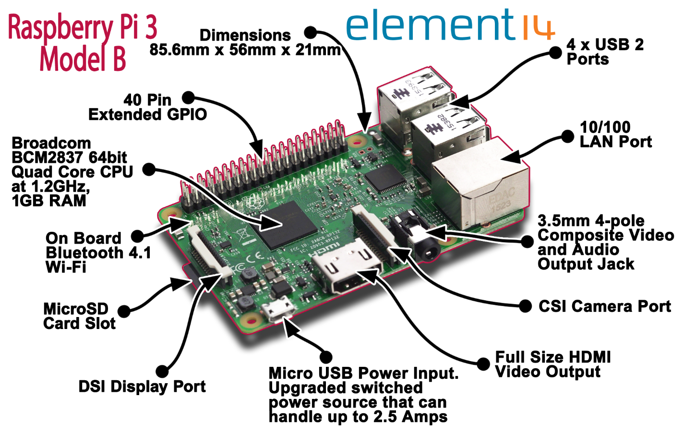
Booting your Raspberry Pi

Slide 3
Getting Started with CanaKit Pi
RTFM (instructions & book, chapter 1)
https://www.raspberrypi.org/help/videos/
Install heatsinks (https://www.youtube.com/watch?v=PiG-jyDq1po )
Install the Pi in the case (p.3) http://www.canakit.com/pi-case
Insert MicroSD card pre-loaded with NOOBS into the MicroSD Card slot.

Slide 4
Getting Started with CanaKit Pi
Connect Keyboard and mouse
Connect HDMI cable to monitor
Skip Step 5 (network cable)
Connect power adapter. Autostarts once power is connected.

Slide 5
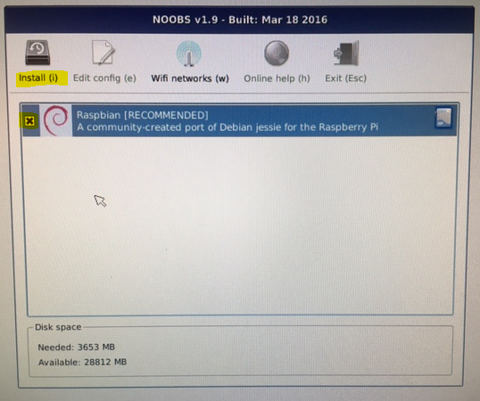
Raspbian and Noobs
Noobs autostarts
Noobs v1.9 – Built March 18, 2016
Select Raspbian and click Install

Slide 6
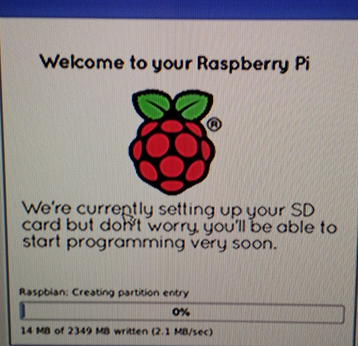
Raspbian and Noobs
Rasbpian installs Wait for it…
Learn about Raspbian
Read the book
Watch videos

Slide 7
Linux on Raspberry Pi
Raspbian and Noobs
NOOBS is a way to make setting up a Raspberry Pi for the first time much, much easier.
Raspbian is a free operating system based on Debian optimized for the Raspberry Pi hardware.
Notes:
https://www.raspbian.org/

Slide 8
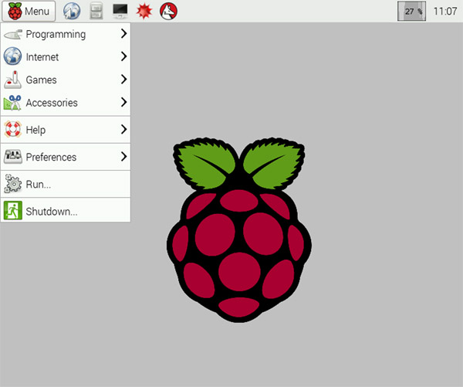
Raspbian

Slide 9
Raspberry Pi Configuration
Menu > Preferences> Raspberry Pi Configuration Set:
Default Password (make sure it’s one you remember)
Hostname (First name, Last Initial)
Locale
Timezone (GMT-5)
Keyboard Layout
Change the keyboard country
Add the following to the /boot/cmdline.txt file
Usbhid.mousepoll=0
It’s not a separate line but goes at the end of the only line in the file (it’s wrapped)
Will need to reboot.

Slide 10
Raspberry Pi Configuration
DO NOT setup network (wifi or bluetooth)

Slide 11
Raspbian Terminal - Linux
Start the Terminal to run Linux commands

